Slide 1

AIV
Autonomous Irrigation Vehicle
Group 4
Joshua Betetta (EE)
Parameswari Chandrasekar (CpE)
Stuart Munich (CpE)
Roberto Santos (EE)
Sponsor by Guard Dog Valves

Slide 2
AIV Motivation
According to the EPA "Depending on the region, homeowners use between 30 and 70 percent of their water outdoors." and Experts estimate that "50 percent of the water we use outdoors goes to waste from evaporation, wind, or runoff due to overwatering."
According to the University of Florida "If you water too much, the roots don't have any incentive to grow deep, so you end up with a lawn that's weak, susceptible to pests, disease and has shallow roots"
We are already exceeding the capacity of the Floridan Aquifer System to supply adequate water to maintain springs health. The only way to restore health to these springs is to greatly reduce our reliance on groundwater from the Floridan Aquifer System.

Slide 3
Existing Issues with Current Watering System and Objectives
Current Issues
Project Objectives
Expensive
Invasive
Frequent Maintenance
User Error
Effective watering
Monitoring soil
User friendly
Autonomous movement & obstacle avoidance
Cost saving
Durable

Slide 4

The Benefits
Cost savings
Modern Sprinkler Head: $50+ annual savings
Moisture Sensors: $35+annual savings
Average Yard: $415+ annual savings
Increased Accuracy of Watering: $15 annual savings
Energy cost of existing small pump: $30 annual
More effective watering
Low maintenance
Overall healthier yard
Availability for bulk application to communities
All cost savings would multiply by multiple yards covered

Slide 5
Specifications
Component | Design Specification
Vehicle Size | 21.10” x 24.13” x 5.55” (L x W x H)
Obstacle Detection Distance | 2 cm to 6 m
Time to Water Designated Area | ≤1 hour per zone
Targeted Rate of Water Flow | 24 Gallons Per Minute
Average Lawn Size | .25 acre (10890 ft^2)
Battery Life | ≤1 hour
Printed Circuit Board Size | 6” x 5” (L x W)

Slide 6
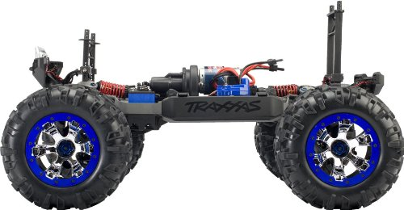
Drive System: Traxxas Summit 1/16th Scale
4 wheel drive
Durable suspension
Modular for modification of all parts
Proper scale for designed prototype
Relatively low weight
Comes with reliable, rechargeable battery

Slide 7
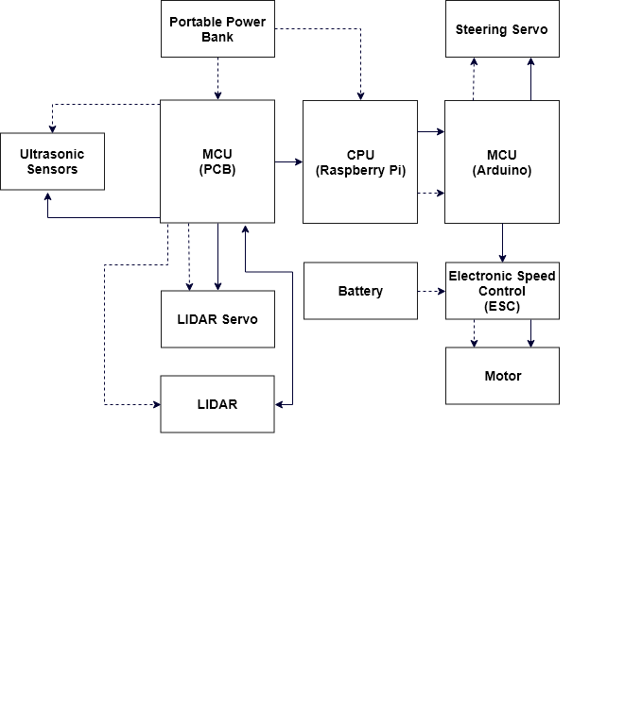
Hardware Block Diagram

Slide 8
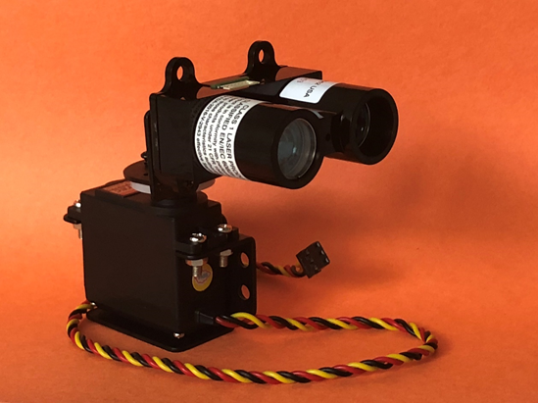
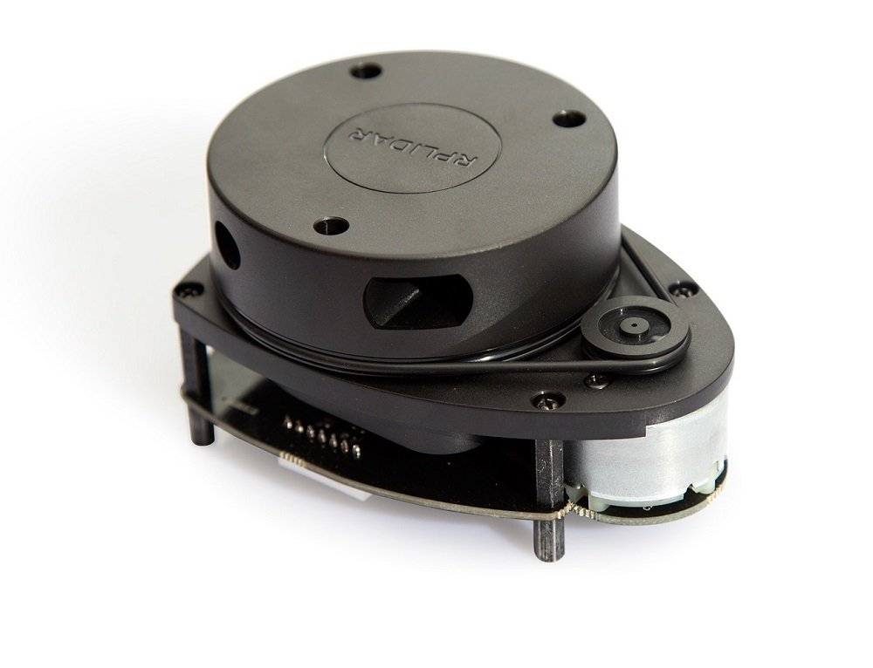
LIDAR
Purpose
Detect long range objects
Weatherproofing
LIDAR
Servo
Manufacturer | Garmin | RPLIDAR
Accuracy | +/- 2.5 cm | +/- 2.5 cm
Range | .05-40 Meters | .2-6 Meters
Power | 4.75-5 VDC | 5 – 10 VDC
Price | $149.99 | $199

Slide 9
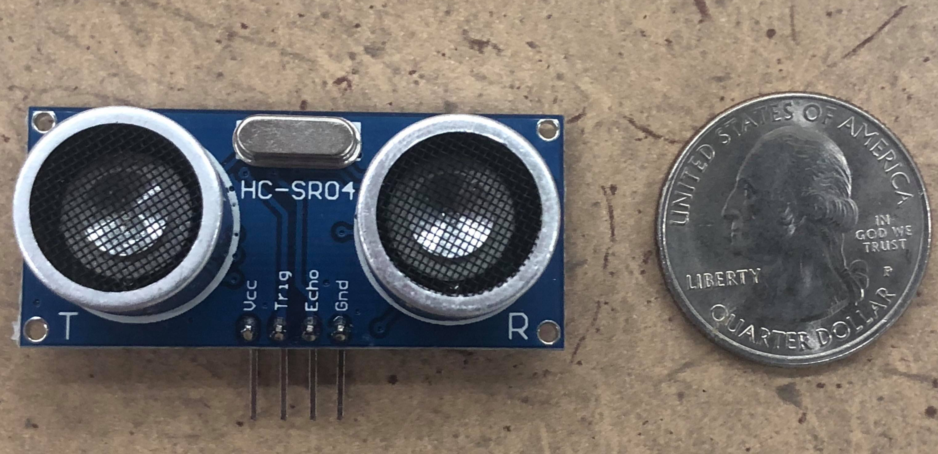
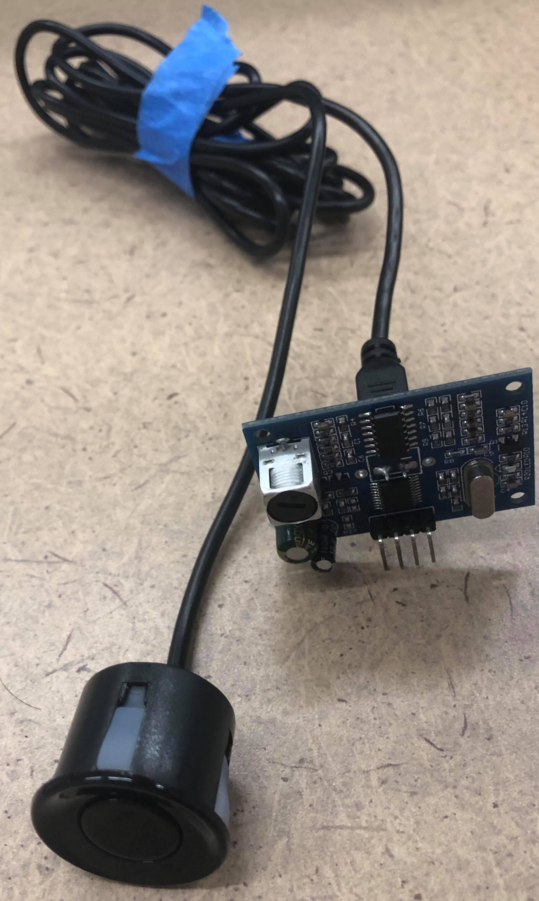
Ultrasonic Range Finder
Purpose
Weatherproof
Detect obstacles
Manufacturer | DFRobot | Axe-Tech
Range | 25 - 450 cm | 2-400 cm
Detecting Angle | < 70° | 15°
Power | 5 VDC | 5 VDC
Price | $16 | $3.50

Slide 10
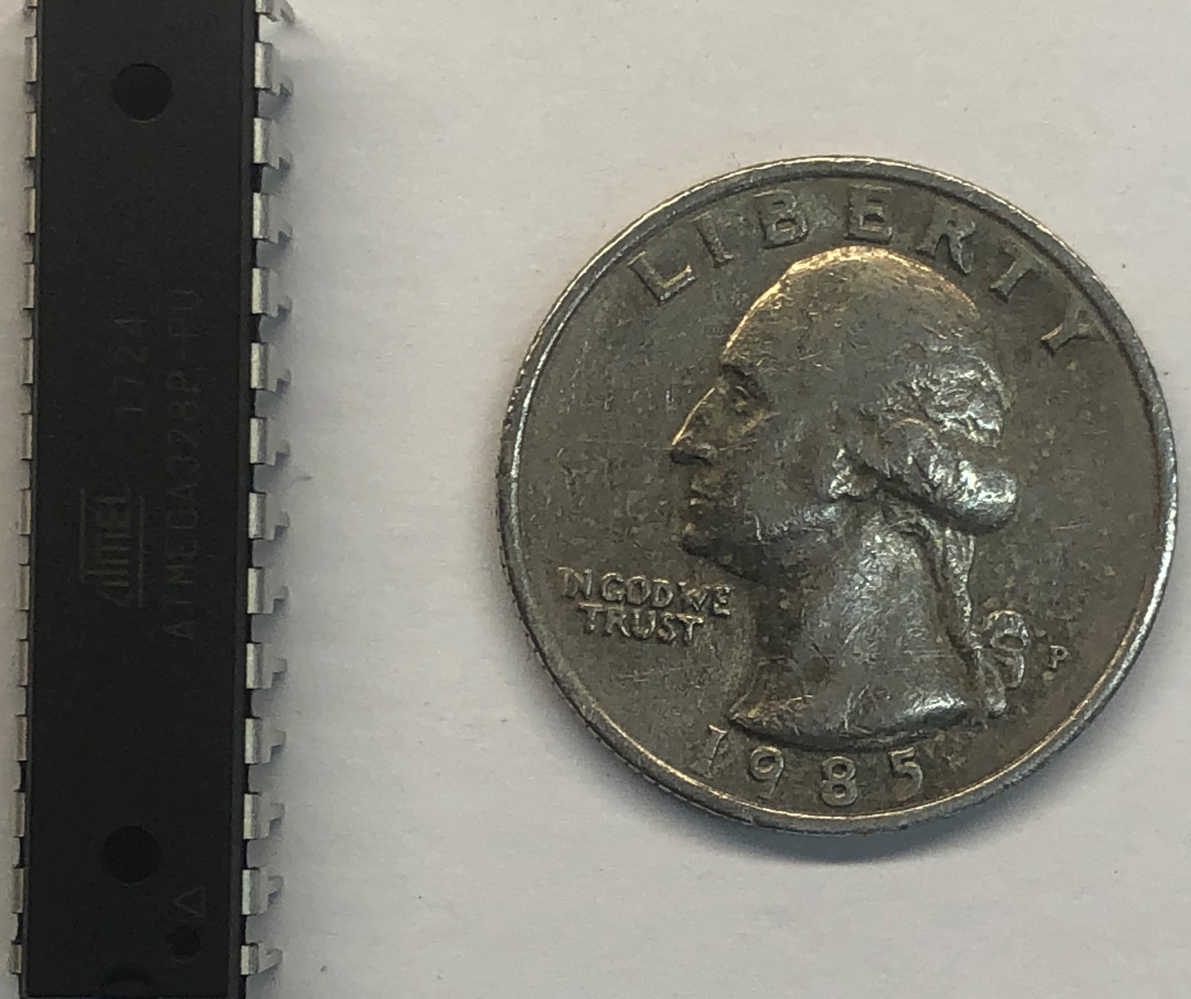
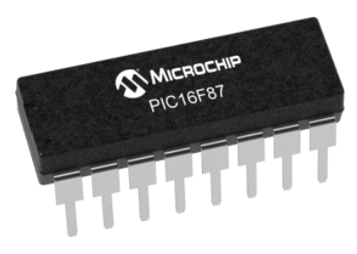
Microcontroller on PCB
ATMEGA32P-PU
Open source
Active community with many resources
PIC16F87A-I/SP
Low capability
Low memory capacity
Manufacturer | Atmel | Atmel
Pin Count | 28 | 16
Speed (MHz) | 20 | 1
Power Supply (V) | 1.8 - 5.5 | 2– 5.5
Price | $2.14 | $2.13

Slide 11
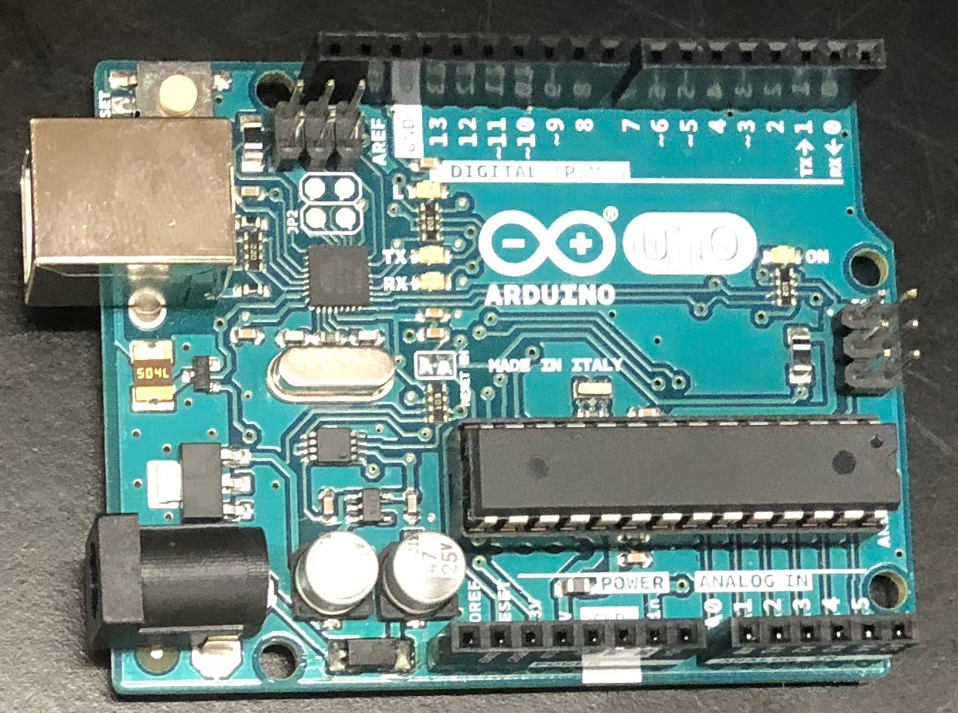
Microcontroller
Arduino
Control vehicle’s
Speed
Acceleration
Steering
Breaking

Slide 12
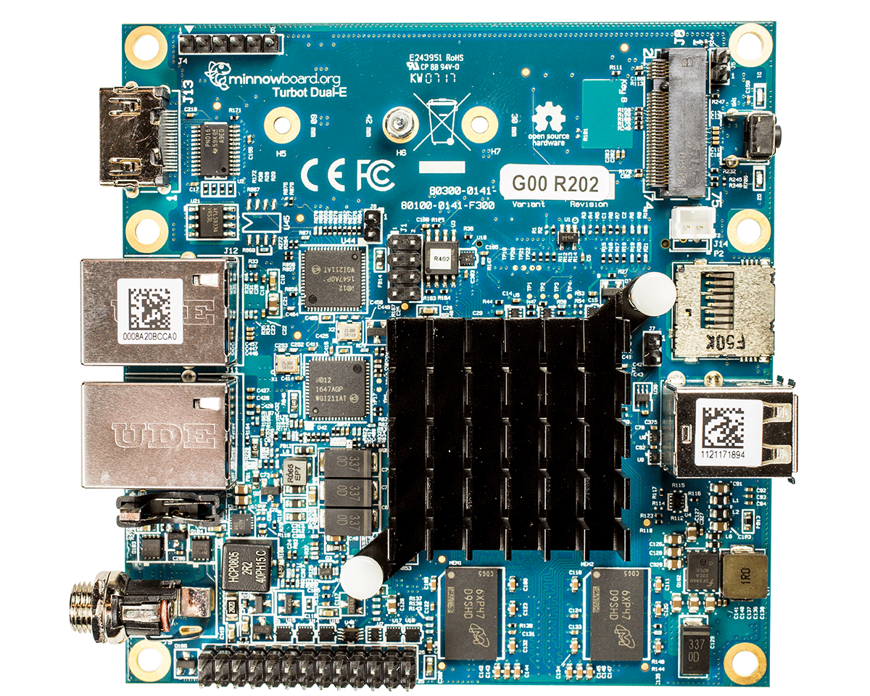
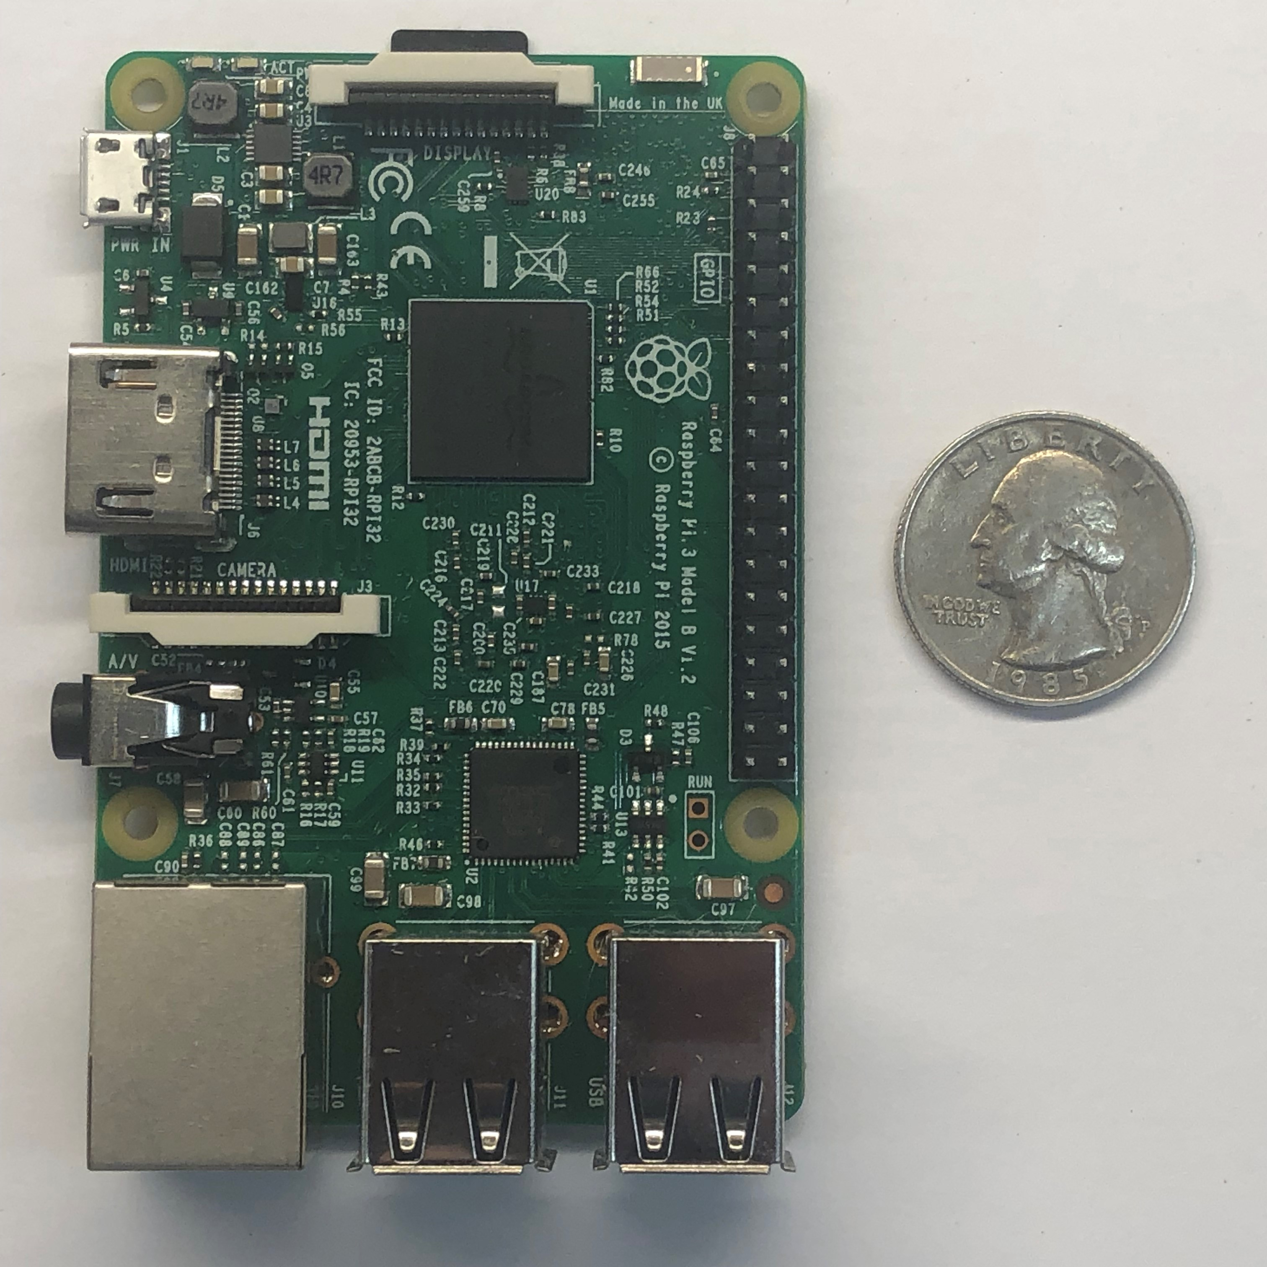
Computer
Raspberry Pi
Analyze & processes received data
Turbot quad-core
Faster & more powerful
Manufacturer | Raspberry Pi Foundation | Intel
CPU | Broadcom BCM2837 | Intel Atom E3845
RAM | 1 GB | 2 GB
Power | 5V @ 2.5A | 5V @ 4A
Price | $35 | $190

Slide 13
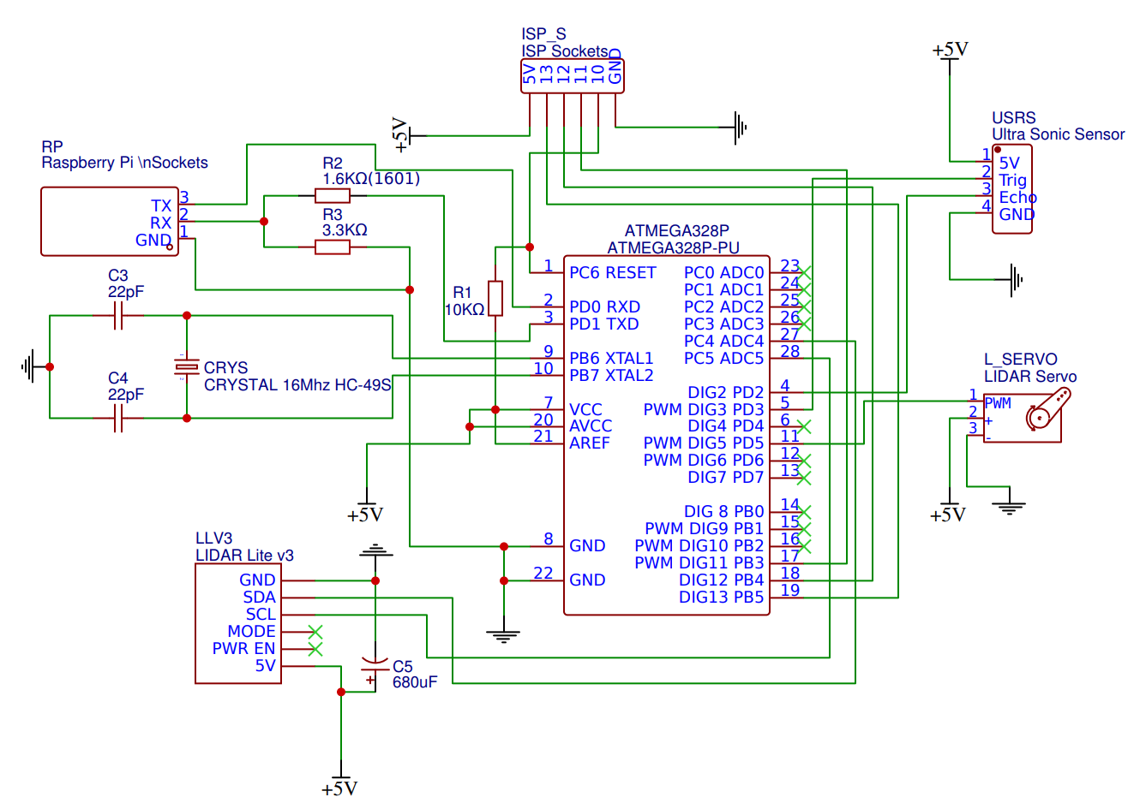
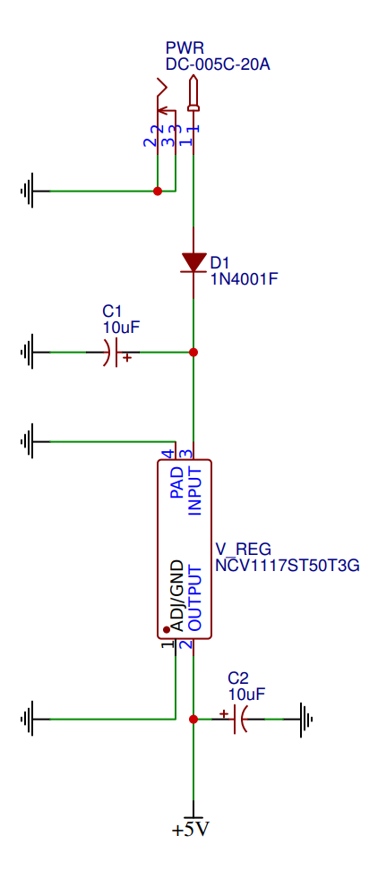
PCB Schematic
Power Circuit
Microcontroller layout

Slide 14
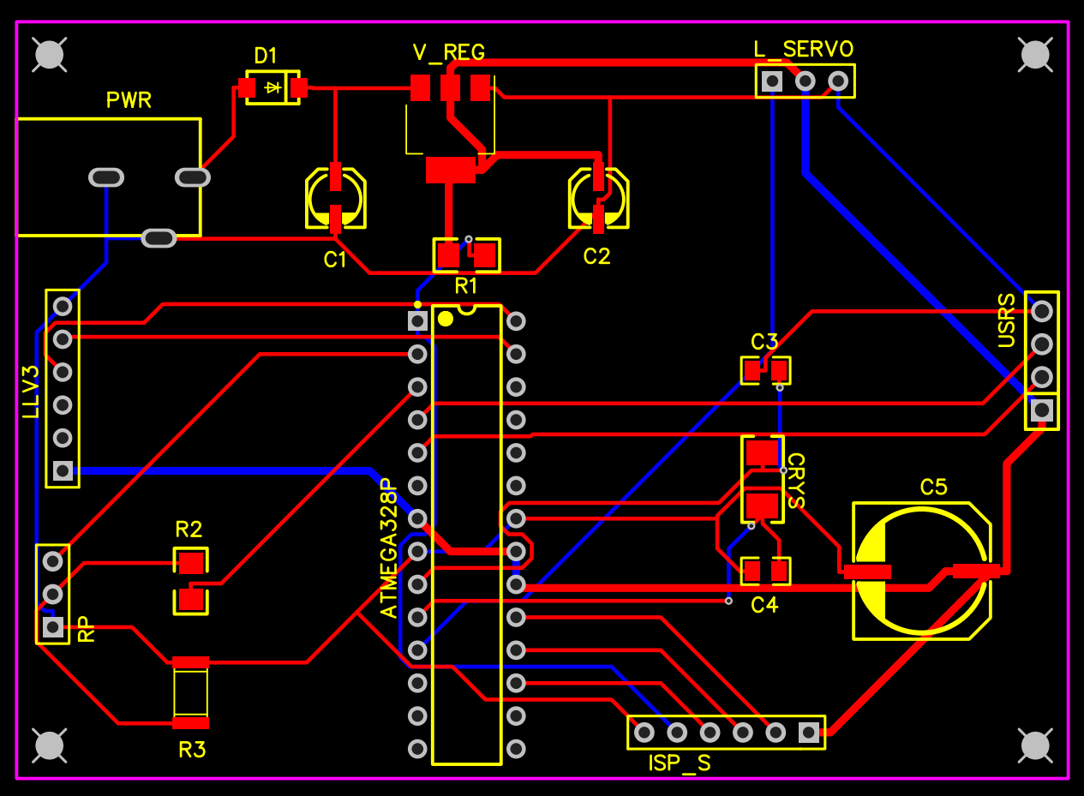
PCB Layout
Indication | Color
Device Outline
Pin Placement
PCB Perimeter
Top Layer Traces
Bottom Layer Traces

Slide 15
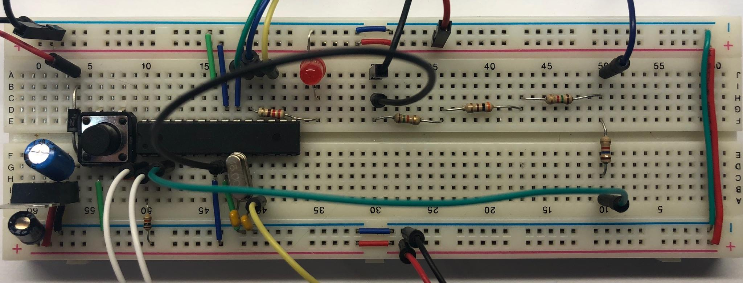
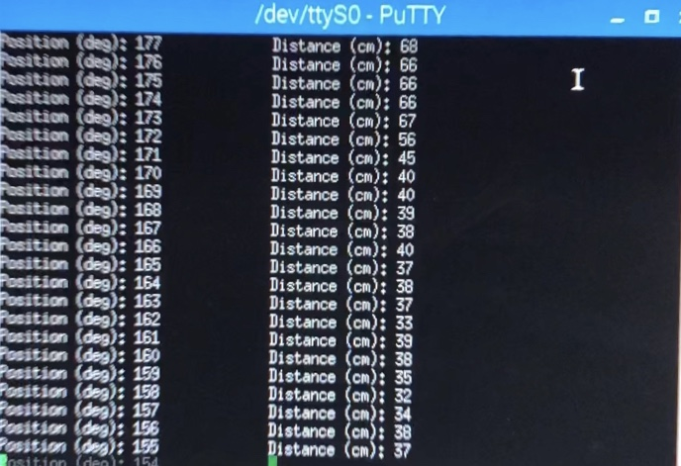
Prototyping
Device | Raspberry Pi | ISP | Servo | Power Jack
Color

Slide 16
SOFTWARE

Slide 17
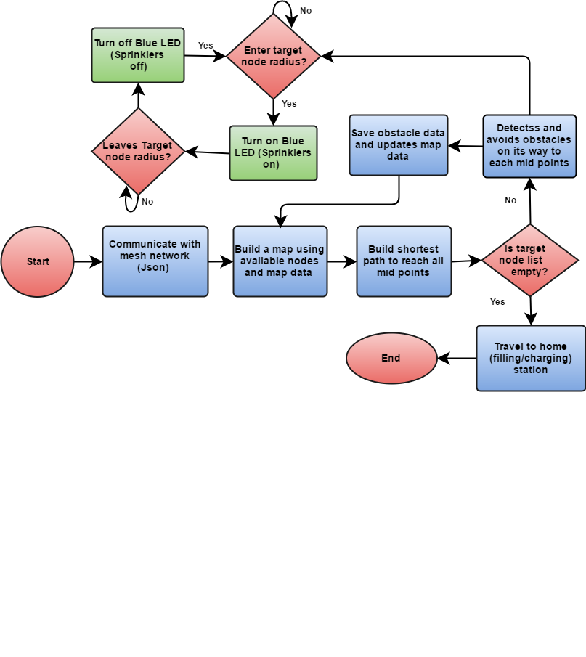
Software Flowchart

Slide 18
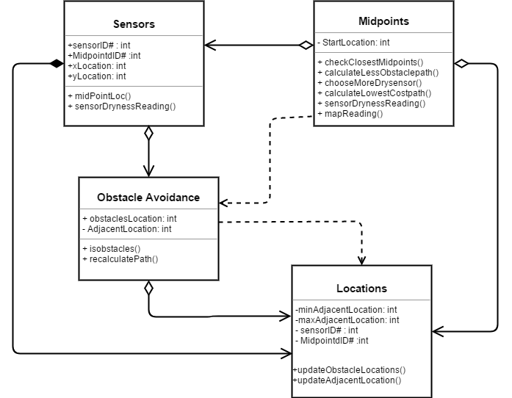
Class Diagram
3 main classes
Midpoints
Locations
Sensors

Slide 19
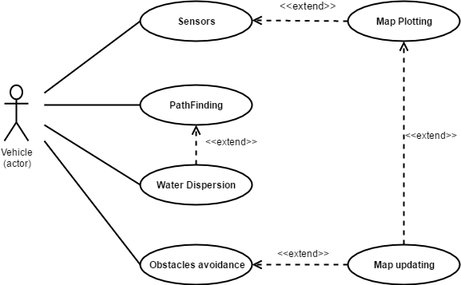
Use Case Diagram

Slide 20
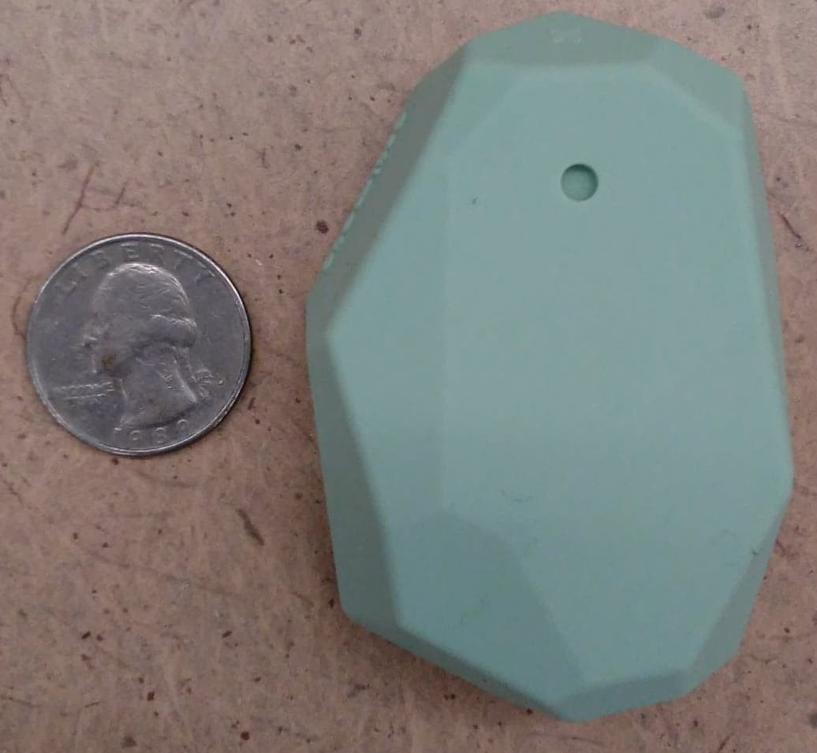
Localization
Proximity sensors
Node.js
Calculates the distance using RSSI (Received Signal Strength Indicator) and measured power
JSON (JavaScript Object Notation)
The distance of the sensors is updated each iteration of the AIV's path where the three nearest ones are used to determine the AIV's position on the map.

Slide 21
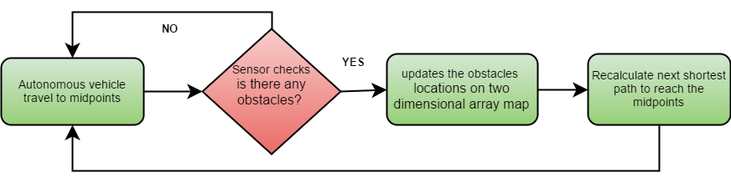
Obstacle Avoidance​
LIDAR​
Learning Phase​
Detects objects on terrain ​
Prevent collisions​
Updates two-dimensional array map​
C++​

Slide 22
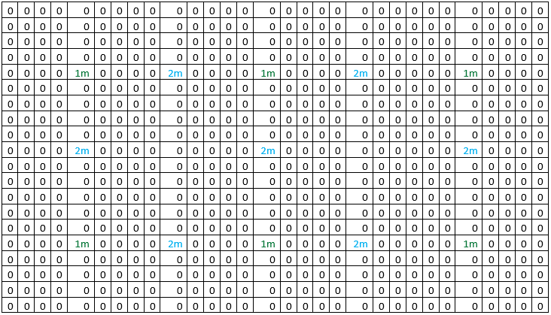
MAP PLOTTING
1m represents sensors
2m represents midpoints
Midpoints are to be used as travel destinations
Midpoints will store the id of the sensors at their edges
They also store the number of sensors at their edges that give dry readings
Maximum dryness of a midpoint is two, minimum is zero.

Slide 23
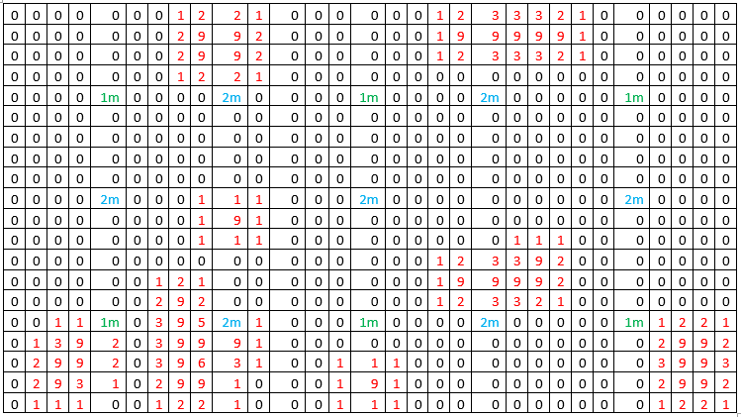
Map Updating​
Two-dimensional array map​
In map number 9 represent obstacle location ​
Maximum number of adjacent obstacle is 8​
Minimum number of adjacent obstacle is 0​
1m represent sensor​
2m represent midpoints

Slide 24
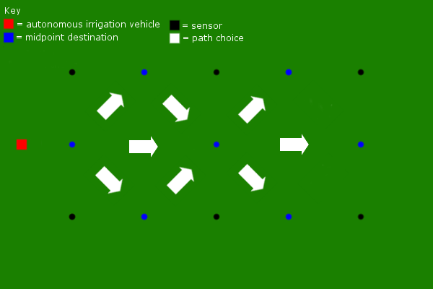
Long Path Finding
Builds a list of midpoints between sensors to travel to.
Orders them based on shortest distance and the readings of sensors at their edge.
Begins by looking to the sensors to its left and right to determine which needs more water.
If both have the same dryness, it moves across the center
If neither are dry, it moves to the neighboring midpoint that is the closest to the next dry midpoint.
The purpose of this is to create a linear path for later when the AIV is attached to a hose.

Slide 25
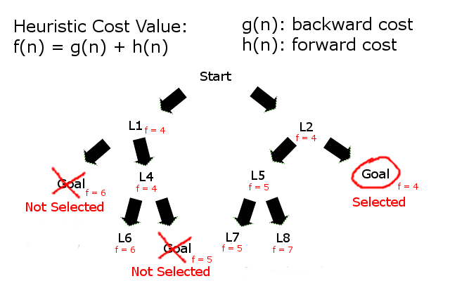
A* Search
Searches all adjacent locations to current location
Calculates heuristic value for each location.
Compares new heuristic to previous value stored in location.
If new heuristic is less than previous one, it adds it to a queue.
Once the goal is reached, it returns a list of locations to reach the goal.

Slide 26
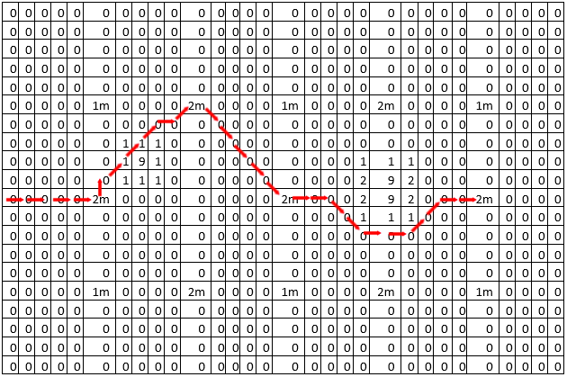
Movement Control of AIV
Takes long path midpoint list
Builds a list of locations to get to each midpoint in the long path using A* Search.
The AIV moves in the direction and distance from current location to the next location on its list.
Keeps track of current location of the AIV while it is moving to each location the list to compare with detected location.
Re-calculates its path if new obstacle is detected or if location is detected off course.
From midpoints: 0 -> 1 -> 3 -> 6

Slide 27
ADMINISTRATIVE CONTENT

Slide 28
Work Distribution
Name | CPU Interfacing | MCU Interfacing | Communication | Algorithm
Joshua | P | S
Parameswari |  |  | P | S
Roberto | S | P
Stuart |  |  | S | P
Primary | P
Secondary | S

Slide 29
Budget
Component | Estimated Cost | Actual Cost | Vendor
LIDAR | $100.00 | $149.99 | RobotShop
Ultrasonic Range Finder | $5.00 | $16.00 | RobotShop
Battery Pack | $15.00 | $59.99 | Amazon
Raspberry Pi | $35.00 | $36.98 | Amazon
Waterproof Servo | $50.00 | $42.99 | RobotShop
Atmega328P | $4.50 | $4.50 | Amazon
Brackets | $20.00 | $17.90 | RobotShop
Traxxas RC Car | $499.99 | $249.95 | Traxxas
Button & RBG LED | $5.00 | $14.95 | Monk Makes
Total | $734.49 | $593.25
Financed by Guard Dog Valves

Slide 30

Questions?

